Slide 1
CNN-based facial expression recognition system
Xiaohu Zhu

Slide 2
Facial Expression Recognition
It plays a critical role in understanding human emotions and has applications in various fields
human-computer interaction, affective computing, psychological research, security, and entertainment.
Accurate classification of facial expressions can lead to improved experiences in fields such as
mental health monitoring
customer service
education

Slide 3
Goal
Develop a novel facial expression recognition system using a blended deep-learning approach.
Enhance accuracy and robustness by leveraging complementary learning capabilities.
Showcase the blended approach impact, benefits, & future works

Slide 4
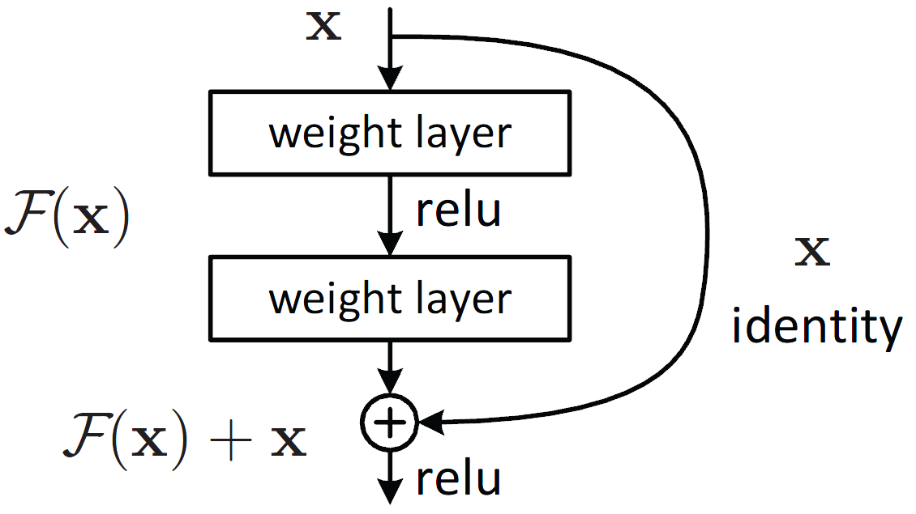
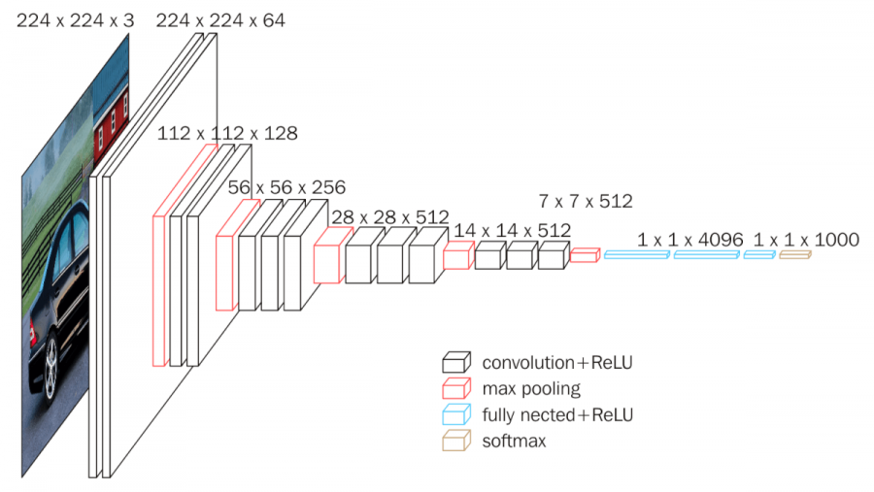
State-of-the-Art
The current state-of-the-art for facial expression recognition is based on deep learning models such as CNNs and RNNs
ResNet
mitigate the vanishing gradient problem
allow the training of deeper networks
High accuracy
VGGNet
Simple and uniform architecture
effective at capturing fine-grained details and local features from facial images

Slide 5
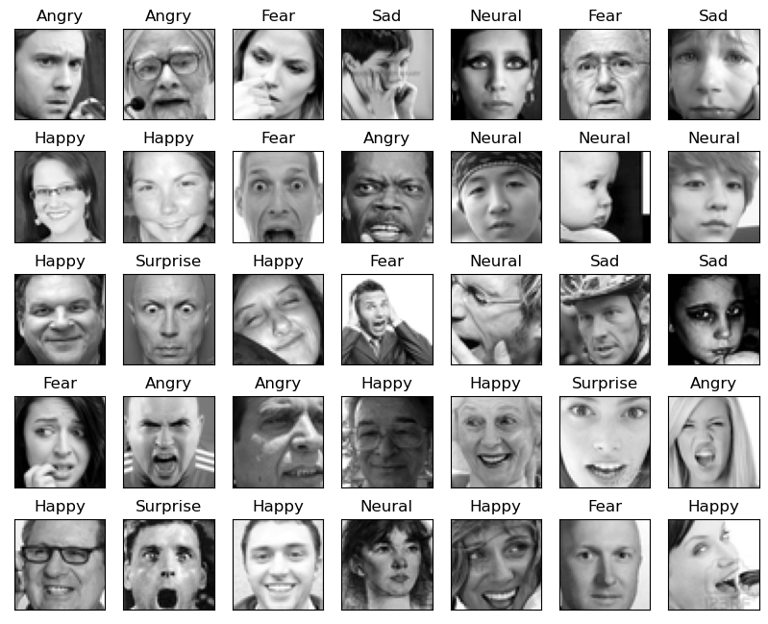
FER dataset
Fer2013 face expression dataset consists of 35886 face expression images, including 28708 test images, 3589 public test images and 3589 private test images, each image is composed of grayscale images with fixed size of 48×48. There are 7 kinds of expressions, respectively corresponding to the numerical labels 0-6, the specific expressions corresponding to the labels are as follows: 0 anger; 1 disgust ; 2 fear ; 3 happy ; 4 sad ; 5 surprised ; 6 normal

Slide 6
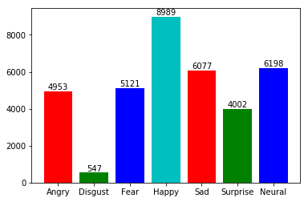
Data preprocessing
The dataset is imbalanced, with the disgust category having the least number of samples.
Geometric transformations
rotation, scaling, and translation
Image normalization and data augmentation techniques

Slide 7
Data preprocessing
Noise reduction
Gaussian blur
median filtering
remove random noise and smooth the images
Landmark detection and alignment
identify key facial points

Slide 8
Proposed Approach and Novelty
Both ResNet and VGGNet have their strengths and weaknesses.
Blended model
The blended approach aims to develop a more accurate facial expression recognition system by combining two well-established deep learning models, VGG19 and ResNet18.
Complementary strengths
capture a broader range of facial features and expression nuances
Robustness and generalization
overcome the limitations of single-model approaches
More accurate

Slide 9
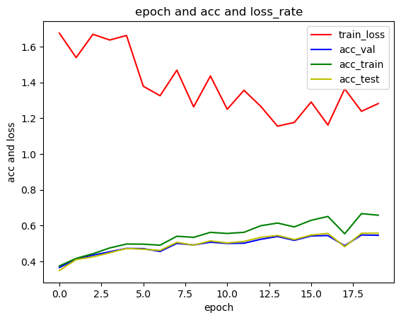
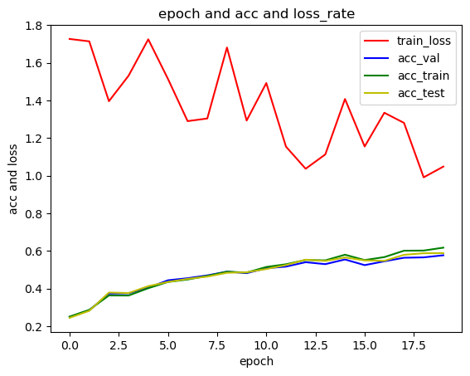
Progress
Training results:
ResNet18
Resnet18 moedel final result：
The acc_train is : 0.6579818175485039
The acc_val is : 0.5458344942881025
The acc_test is : 0.5572582892170521
VGGNet19
VGG19 final result：
The acc_train is : 0.6178550280399875
The acc_val is : 0.5773195876288659
The acc_test is : 0.5887433825578156

Slide 10
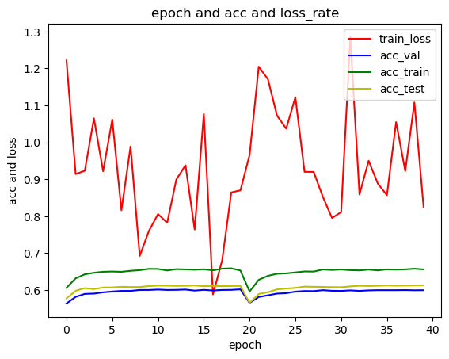
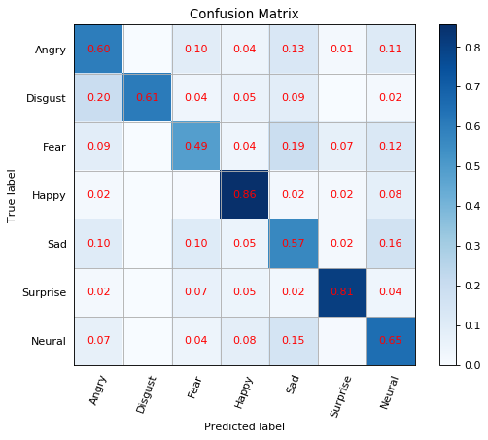
Result
Blended model
Accuracy0.6748397882418501

Slide 11
Evaluation
Angry
result： [0, 0, 0, 0, 0, 0, 0, 0]
predicted result： [0, 0, 0, 0, 4, 0, 2, 0]
Disgust
result： [1, 1, 1, 1 ,1 ,1 ,1 ,1]
predicted result： [1, 4, 1, 1, 2, 4, 1 ,1]
Fear
result： [2, 2, 2, 2, 2, 2, 2, 2, 2, 2, 2, 2, 2, 2, 2, 2, 2, 2, 2]
predicted result： [4, 6, 6, 2, 2, 2, 3, 0, 2, 2, 2, 2, 0, 2, 0, 6, 5, 3, 2]
Happy
result： [3, 3, 3, 3, 3, 3, 3, 3, 3, 3, 3, 3, 3, 3, 3, 3, 3, 3, 3, 3, 3, 3, 3, 3, 3, 3, 3, 3, 3]
predicted result： [6, 3, 3, 3, 3, 3, 3, 3, 0, 3, 3, 3, 3, 3, 3, 0, 3, 3, 3, 3, 3, 3, 3, 3, 3, 6, 3, 4, 0]
Sad
result： [4, 4, 4, 4, 4, 4, 4, 4, 4, 4, 4, 4, 4, 4, 4, 4, 4, 4]
predicted result： [4, 4, 4, 3, 4, 0, 6, 0, 3, 2, 4, 4, 4, 4, 2, 4, 3, 4]
Surprise
result： [5, 5, 5, 5, 5, 5, 5, 5, 5]
predicted result： [5, 3, 5, 5, 5, 5, 5, 5, 6]
Neural
result： [6, 6, 6, 6, 6, 6, 6, 6, 6, 6, 6, 6, 6, 6, 6]
predicted result： [2, 6, 3, 6, 6, 3, 6, 6, 6, 6, 6, 6, 0, 4, 6]

Slide 12
Benefits & future works
Multi-modal facial expression recognition
accurate and holistic emotion recognition
Real-time applications
human-computer interaction
mental health monitoring
customer experience
entertainment
education

Slide 13
Reference
[1] A. Mollahosseini, D. Chan, and M. H. Mahoor, "Deep Emotion Recognition on Small Datasets using Transfer Learning," in Proceedings of the IEEE Conference on Computer Vision and Pattern Recognition Workshops, 2017, pp. 10-19.
[2] J. H. Yang and J. Lu, "Facial Expression Recognition with Deep Convolutional Neural Networks," in Proceedings of the 2018 IEEE International Conference on Multimedia and Expo (ICME), 2018, pp. 1-6.

Slide 14
Thank you!

